Slide 1
Evolution of Programming Languages

Slide 2
Importance of Studying Programming Languages
1. Increased capacity to express ideas:
People can easily express their ideas clearly in any language only when they have clear understanding of the natural language.
Similarly, if programmers want to simulate the features of languages in another language, they should have some ideas regarding the concepts in other languages as well.
2. Improved background for choosing appropriate languages
Many programmers when given a choice of languages for a new project, continue to use the language with which they are most familiar, even if it is poorly suited to the project.
If these programmers were familiar with a wider range of languages, they would be better able to choose the language that includes the features that best address the characteristics of the problem at hand.

Slide 3
Importance of Studying Programming Languages
3. Increased ability to learn new languages
In software development, continuous learning is essential.
The process of learning a new programming language can be lengthy and difficult, especially for someone who is comfortable with only two or more languages.
Once a thorough understanding of the fundamental concepts of languages is acquired, it becomes far easier to see how these concepts are incorporated into the design of the language being learned.
4. Better understanding the significance of implementation
An understanding of implementation issues leads to an understanding of why languages are designed the way they are.
This knowledge in turn leads to the ability to use a language more intelligently, as it was designed to use.
We can become better programmers by understanding the choices among programming language constructs and consequences of those choices.

Slide 4
Importance of Studying Programming Languages
5. Better use of languages that are already known
By studying the concepts of programming languages, programmers can learn about previously unknown and unused parts of the languages they already use and begin to use those features.

Slide 5
Generation of PL
First Generation Languages
Sometimes referred to as machine code or object code, machine language is a collection of binary digits or bits that the computer reads and interprets. Machine language is the only language a computer is capable of understanding.
Second Generation Languages
Assembly language is a low-level programming language for a computer or other programmable device specific to a particular computer architecture in contrast to most high-level programming languages, which are generally portable across multiple systems. Assembly language is converted into executable machine code by a utility program referred to as an assembler.

Slide 6
Generation of PL
Third Generation Languages
A high-level language is a programming language designed to simplify computer programming.
It is “high-level” since it is several steps removed from the actual code run on a computer’s processor.
High-level source code contains easy-to-read syntax that is later converted into a low-level language, which can be recognized and run by a specific CPU.
Example : C, C++, Java, Visual Basic and JavaScript
Fourth Generation Languages
A fourth-generation programming language (4GL) is any computer programming language that belongs to a class of languages envisioned as an advancement upon third-generation programming languages (3GL).
Each of the programming language generations aims to provide a higher level of abstraction of the internal computer hardware details, making the language more programmer-friendly, powerful, and versatile.
While the definition of 4GL has changed over time, it can be typified by operating more with large collections of information at once rather than focusing on just bits and bytes.
Languages claimed to be 4GL may include support for database management, report generation, mathematical optimization, GUI development, or web development. Some researchers state that 4GLs are a subset of domain-specific languages.
Example : Perl, Python, Ruby, SQL, MatLab(MatrixLaboratory)

Slide 7
Generation of PL
Fifth Generation Languages
A fifth-generation programming language (5GL) is any programming language based on problem-solving using constraints given to the program, rather than using an algorithm written by a programmer. Most constraint-based and logic programming languages and some other declarative languages are fifth-generation languages.
While fourth-generation programming languages are designed to build specific programs, fifth-generation languages are designed to make the computer solve a given problem without the programmer. This way, the user only needs to worry about what problems need to be solved and what conditions need to be met, without worrying about how to implement a routine or algorithm to solve them. Fifth-generation languages are used mainly in artificial intelligence research.
Example : OPS5 and Mercury programming language.

Slide 8
Motivational Factor for Development of PL
1. Readability
One of the most important criteria for judging a programming language is the ease with which programs can be read and understood.
Language constructs were designed more from the point of view of the computer than of computer users
From 1970s, the S/W life cycle concept was developed; coding was relegated to a much smaller role, and maintenance was recognized as a major part of the cycle, particularly in terms of cost. Because ease of maintenance is determined in large part by readability of programs, readability became an important measure of the quality of programs.
2. Overall simplicity
Language with too many features is more difficult to learn

Slide 9
Motivational Factor for Development of PL
3. Orthogonality
A relatively small set of primitive constructs that can be combined in a relatively small number of ways
Consistent set of rules for combining constructs (simplicity)
Every possible combination is legal
Makes the language easy to learn and read
Meaning is context independent
Orthogonality is closely related to simplicity. The more orthogonal the design of a language, the fewer exceptions the language rules require. Fewer exceptions mean a higher degree of regularity in the design, which makes the language easier to learn, read, and understand.

Slide 10
Motivational Factor for Development of PL
4. Writability
Most readability factors also apply to writability
Simplicity and orthogonality
Control statements, data types and structures
Support for abstraction
Data abstraction
Process abstraction
Expressivity

Slide 11
Motivational Factor for Development of PL
5. Reliability
A program is said to be reliable if performs to its specifications under all conditions.
– Type checking
Type checking is simply testing for type errors in a given program, either by the compiler or during the program execution
Because run time type checking is expensive, compile time type checking is more desirable
Famous failure of space shuttle experiment due to int / float mix-up in parameter passing
– Exception handling
Ability to intercept run-time errors
– Aliasing
Ability to use different names to reference the same memory
A dangerous feature

Slide 12
Motivational Factor for Development of PL
6. Cost
Training programmers to use language
Writing programs in a particular problem domain
Compiling programs
Executing programs
Language implementation system (free?)
Reliability
Maintaining programs

Slide 13
Characteristics of a good language
1. Naturalness:
A good language should be natural for the application area for which it is designed.
That is, it should provide appropriate operators, data structures, control structures and a natural syntax to facilitate programmers to code their problems easily and efficiently.
2. Abstraction:
Abstraction means ability to define and then use complicated structures or operations in ways that allow many of the details to be ignored.
The degree of abstraction allowed by a language directly affects its ease of programming. For Example, object-oriented languages support high degree of abstraction.
Hence, writing programs in object-oriented languages is much easier. Object-oriented also support re usability of program segments due to this feature.

Slide 14
Characteristics of a good language
3.Efficiency: Programs written in a good language are translated into machine code efficiently, are executed and require relatively less space in memory. That is, a good programming language is supported with a good language translator (a compiler or an interpreter) that gives due consideration to space and time efficiency.
4.Structured Programming Support:
A good language should have necessary features to allow programmers to write their programs based on the concepts of structured programming.
This property greatly affects the ease with which a program may be written., tested and maintained. More over, it forces a programmer to look at a problem in a logical way so that fewer errors are created while writing a program for the problem.

Slide 15
Characteristics of a good language
5.Compactness:
In a good language, programmers should be able to express the intended operations concisely without losing readability. Programmers generally do not like a verbose language because they need to write too much.
6. Extensibility:
A good language should also allow extensions through a simply, natural and elegant mechanism.

Slide 16
Pseudocode
The term "pseudo code" is frequently used in programming and algorithmic domains. It is a programming paradigm that allows a programmer to represent an algorithm's implementation. Simply said, it is the fabricated representation of an algorithm.
Algorithms are frequently represented using pseudo codes because they can be comprehended by programmers regardless of their programming background or knowledge.
As the name implies, pseudo code is a invented code or representation of code that can be understood by anyone with a basic understanding of programming.

Slide 17
Pseudo code
Pseudocode Writing Technique:
Arrange the tasks in the correct order and write the pseudocode.
Begin with a pseudocode statement that states the main purpose or objective.
Indent the statements in the same way that the if-else, for, and while loops are indented in a program, as this helps to understand the decision control and execution process. They also significantly increase readability.
Use naming standards that are appropriate. Humans have a tendency to follow what they observe. Because a programmer's approach will be similar to that of a pseudo code, the naming must be simple and unique.
Use appropriate sentence casings, such as Camel Case for methods, upper case for constants and lower case for variables.
Elaborate everything which is going to happen in the actual code. Don’t make the pseudo code abstract.
Use standard programming structures such as ‘if-then’, ‘for’, ‘while’, ‘cases’ the way we use it in programming.
Check whether all the sections of a pseudo code is complete, finite and clear to understand and comprehend.

Slide 18
Pseudo code
Pseudo-Code interpreter (a primitive, interpreted programming language) implements:
A virtual computer
New instruction set
New data structures
Virtual computer:
Higher level than actual hardware
Provides facilities more suitable to applications
Abstracts away hardware details

Slide 19
Pseudo code
Pseudo Code follows two basic Principles of Programming
The Automation Principle
Automate mechanical, tedious, or error prone activities.
The Regularity Principle
Regular rules, without exceptions, are easier to learn, use, describe, and implement.
Pseudo Code should accommodate following functionality:
Floating-point arithmetic
Floating –point comparison
Indexing
Transfer of Control
Input -Output

Slide 20
Some Exercise of Pseudo code
1. Write a pseudo code for method named isDivisible that takes an integer array and a divisor and returns 1 if all its elements are divided by the divisor with no remainder. Otherwise it returns 0.

Slide 21
Different types of Language Categories
Imperative
Central features are variables, assignment statements, and iteration
– Examples: C, Pascal
Functional
Main means of making computations is by applying functions to given parameters
Examples: LISP
III. Logic (declarative)
Rule-based (rules are specified in no particular order)
Example: Prolog
Object-oriented
Markup
not a programming , but used to specify the layout of information in Web documents

Slide 22
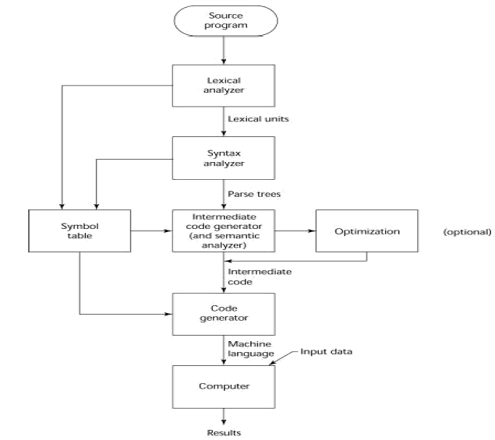
Fig. Compilation Process

